Slide 1

Unit-1 Introduction to Big Data
Big Data Analytics(BDA)
GTU #3170722
Prof. Maulik D. Trivedi
Computer Engineering Department
maulik.trivedi@darshan.ac.in
9998 265 805

Slide 2

Looping
Outline
Introduction to Big Data
Big Data Characteristics
Challenges of Conventional System
Types of Big Data
Intelligent Data Analysis
Traditional vs. Big Data business Approach
Case Study of Big Data Solutions

Slide 3
Introduction to Big Data

Slide 4
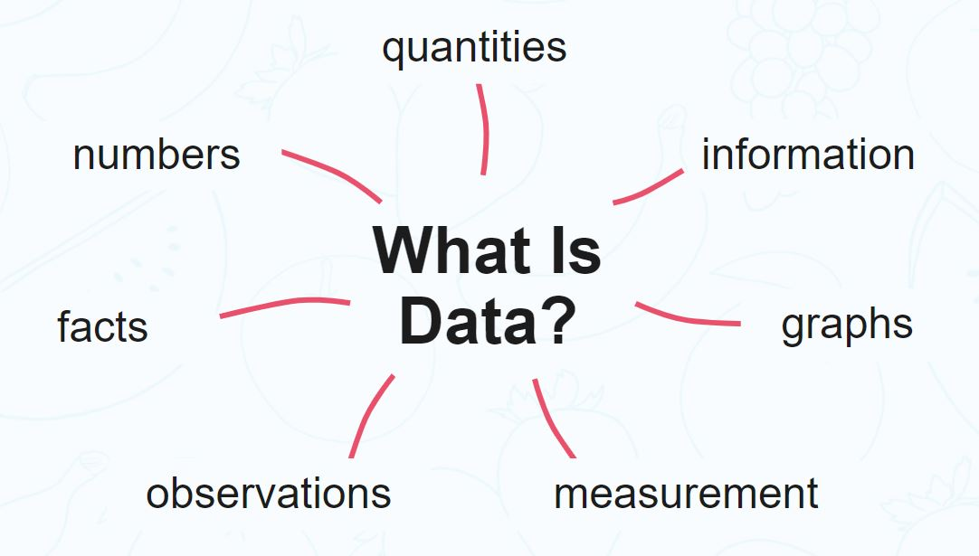
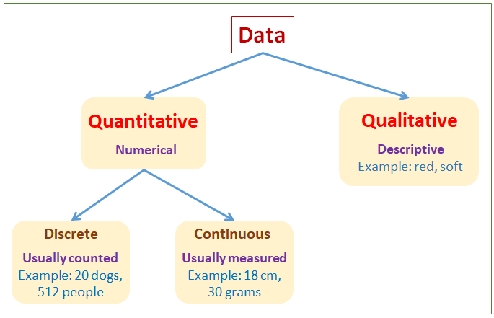
Introduction
Firstly, We need to know “what is data?”
The quantities, characters, or symbols on which operations are performed by a computer, which may be stored and transmitted in the form of electrical signals and recorded on magnetic, optical, or mechanical recording media.
Data Comes From
Types of Data

Slide 5
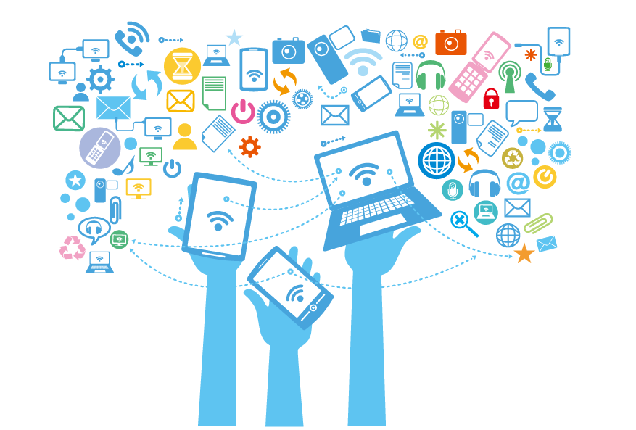
Computer Data as Information
Computer data is information processed or stored by a computer.
This information may be in the form of text documents, images, audio clips, software programs, or other types of data.
Computer data may be processed by the computer's CPU and is stored in files and folders on the computer's hard disk.

Slide 6
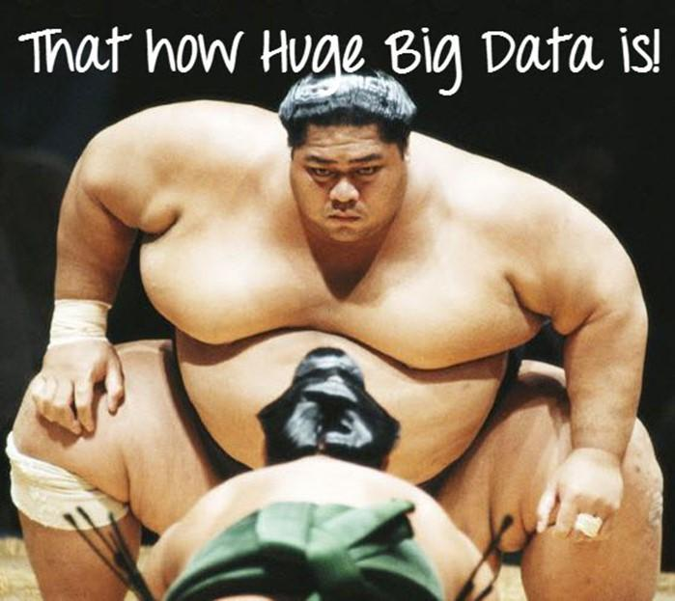
Definition – Big Data
Big Data is a massive collection of data that continues to grow dramatically over time.
It is a data set that is so huge and complicated that no typical data management technologies can effectively store or process it.
Big Data is like regular data, but it is much larger.
A data which are very large in size.
Normally we work on data of size MB(WordDoc ,Excel) or maximum GB(Movies, Codes) but data in Peta bytes i.e. 10¹⁵ byte size is called Big Data.
It is stated that almost 90% of today's data has been generated in the past 3 years.

Slide 7






Sources of Big Data
Posts, Photos Videos, Likes and Comments on Social Media
Traffic data & GPS Signals
Emails, Blogs and e-news
Software logs, camera and microphone
Huge data from Weather station and satellite that stored and manipulated to forecasting
Digital Pictures & Videos

Slide 8
Big Data Characteristics

Slide 9
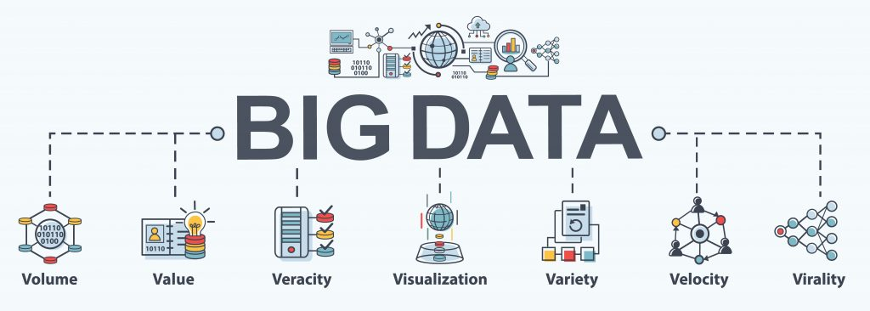
Big Data Characteristics
Volume represents the volume i.e. amount of data that is growing at a high rate i.e. data volume in Petabytes.

Slide 10
Big Data Characteristics
Value refers to turning data into value. By turning accessed big data into values, businesses may generate revenue.

Slide 11
Big Data Characteristics
Veracity refers to the uncertainty of available data. Veracity arises due to the high volume of data that brings incompleteness and inconsistency.

Slide 12
Big Data Characteristics
Visualization is the process of displaying data in charts, graphs, maps, and other visual forms.

Slide 13
Big Data Characteristics
Variety refers to the different data types i.e. various data formats like text, audios, videos, etc.

Slide 14
Big Data Characteristics
Velocity is the rate at which data grows. Social media contributes a major role in the velocity of growing data.

Slide 15
Big Data Characteristics
Virality describes how quickly information gets spread across people to people (P2P) networks.

Slide 16

Volume
As it follows from the name, big data is used to refer to enormous amounts of information.
We are talking about not gigabytes but terabytes and petabytes of data.
The IoT (Internet of Things) is creating exponential growth in data.
The volume of data is projected to change significantly in the coming years.
Hence, 'Volume' is one characteristic which needs to be considered while dealing with Big Data.
Volume
[ Data at Rest ]
Terabytes, Petabytes
Records/Arch
Table/Files
Distributed

Slide 17
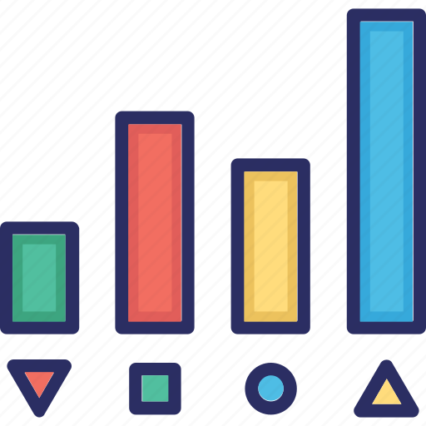
Variety
Variety refers to heterogeneous sources and the nature of data, both structured and unstructured.
Data comes in different formats – from structured, numeric data in traditional databases to unstructured text documents, emails, videos, audios, stock ticker data and financial transactions.
This variety of unstructured data poses certain issues for storage, mining and analysing data.
Organizing the data in a meaningful way is no simple task, especially when the data itself changes rapidly.
Another challenge of Big Data processing goes beyond the massive volumes and increasing velocities of data but also in manipulating the enormous variety of these data.
Variety
[ Data in many Forms ]
Structured
Unstructured
Text
Multimedia

Slide 18

Veracity
Veracity describes whether the data can be trusted.
Veracity refers to the uncertainty of available data.
Veracity arises due to the high volume of data that brings incompleteness and inconsistency.
Hygiene of data in analytics is important because otherwise, you cannot guarantee the accuracy of your results.
Because data comes from so many different sources, it’s difficult to link, match, cleanse and transform data across systems.
However, it is useless if the data being analysed are inaccurate or incomplete.
Veracity is all about making sure the data is accurate, which requires processes to keep the bad data from accumulating in your systems.
Veracity
[ Data in Doubt ]
Trustworthiness
Authenticity
Accurate
Availability

Slide 19

Velocity
Velocity is the speed in which data is grows, process and becomes accessible.
A data flows in from sources like business processes, application logs, networks, and social media sites, sensors, Mobile devices, etc.
The flow of data is massive and continuous.
Most data are warehoused before analysis, there is an increasing need for real-time processing of these enormous volumes.
Real-time processing reduces storage requirements while providing more responsive, accurate and profitable responses.
It should be processed fast by batch, in a stream-like manner because it just keeps growing every years.
Velocity
[ Data in Motion ]
Streaming
Batch
Real / Near Time
Processes

Slide 20

Value
It refers to turning data into value. By turning accessed big data into values, businesses may generate revenue.
Value is the end game. After addressing volume, velocity, variety, variability, veracity, and visualization – which takes a lot of time, effort and resources – you want to be sure your organization is getting value from the data.
For example, data that can be used to analyze consumer behavior is valuable for your company because you can use the research results to make individualized offers.
Value
[ Data into Money ]
Statistical
Events
Correlations

Slide 21
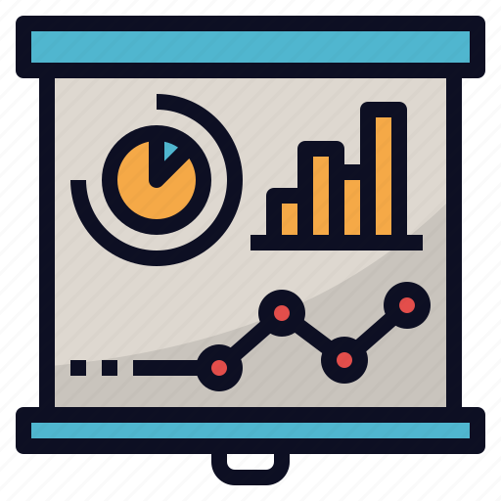
Visualization
Big data visualization is the process of displaying data in charts, graphs, maps, and other visual forms.
It is used to help people easily understand and interpret their data at a glance, and to clearly show trends and patterns that arise from this data.
Raw data comes in a different formats, so creating data visualizations is process of gathering, managing, and transforming data into a format that’s most usable and meaningful.
Big Data Visualization makes your data as accessible as possible to everyone within your organization, whether they have technical data skills or not.
Visualization
[ Data Readable ]
Readable
Accessible
Presentation
Visual Forms

Slide 22

Virality
Virality describes how quickly information gets spread across people to people (P2P) networks.
It is measures how quickly data is spread and shared to each unique node.
Time is a determinant factor along with rate of spread.
Virality
[ Data Spread ]
P2P
Shared
Rate of Spread

Slide 23
Challenges of Conventional System

Slide 24
Challenges of Conventional System
There are main three challenges of conventional system, which are as follows:
Volume of Data
Processing and Analyzing
Management of Data

Slide 25
Volume of Data
The volume of data increasing day by day, especially the data generated from machine, telecommunication service, airline services, data from sensors, etc…
The rapid growth in data every year is coming with new source of data which are emerging.
As per survey, the growth in volume of data is so rapid that it is expected by IBM that by 2020 around 35 zettabyte of data will get stored in the world.

Slide 26
Processing & Analyzing
Processing of such large volume of data is major challenge and is very difficult.
Organization make use of such large volume of data by analyzing in order to achieve their business goals.
Taking out insights from such large amount of data is time consuming and it also takes lot of effort to do.
Processing and analyzing of data is also costly since the data is in different format and is complex.

Slide 27
Management of Data
As the data gathered have different formats like structured, semi-structured and unstructured, it is very challenging to manage such different variety of data.

Slide 28
Types of Big Data

Slide 29
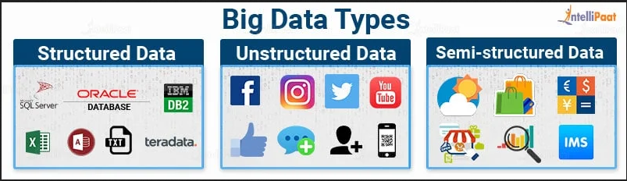
Types of Big Data
Unstructured
Semi-structured
Structured

Slide 30





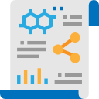






Unstructured
Any data with unknown form or the structure is classified as unstructured data.
In addition to the size being huge, un-structured data poses multiple challenges in terms of its processing for deriving value out of it.
Typical example of unstructured data is, a heterogeneous data source containing a combination of simple text files, images, videos like search in Google Engine.
Now a day organizations have wealth of data available with them but unfortunately they don't know how to derive value out of it since this data is in its raw form or unstructured format.
Human Generated Data
Machine Generated Data

Slide 31
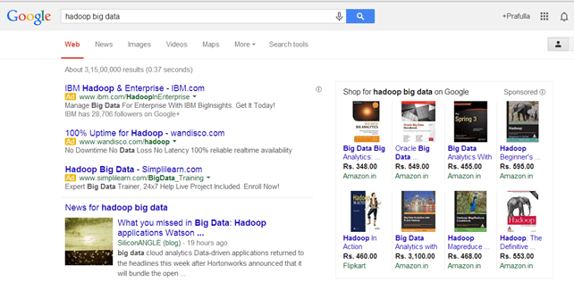
Unstructured - Example
The output returned by 'Google Search'

Slide 32
Structured
Any data that can be stored, accessed and processed in the form of fixed format is termed as a "Structured" data.
Over the period of time, talent in computer science have achieved greater success in developing techniques for working with such kind of data (where the format is well known in advance) and also determining value out of it.
When size of such data grows to a huge extent, typical sizes are being in the range of multiple zettabyte.
Data stored in a relational database management system in one example of a structured data.

Slide 33
Structured - Example
Employee_Table
Employee_ID | Employee_Name | Gender | Department | Salary_In_lacs
1 | XYX | MALE | FINANCE | 850000
2 | ABC | MALE | ADMIN | 250000
3 | PQR | FEMALE | SALES | 350000
4 | MNR | FEMALE | FINANCE | 600000

Slide 34
Semi-structured
Semi structured is the third type of big data.
Semi-structured data can contain both the forms of data.
Semi-structured data pertains to the data containing both the formats mentioned above, that is, structured and unstructured data.
To be precise, it refers to the data that although has not been classified under a particular repository (database), yet contains vital information or tags that segregate individual elements within the data.
Web application data, which is unstructured, consists of log files, transaction history files etc.
Online transaction processing systems are built to work with structured data wherein data is stored in relations (tables).

Slide 35
Semi-structured - Example
User can see semi-structured data as a structured in form but it is actually not defined with e.g. a table definition in relational DBMS.
Personal data stored in a XML file:
<rec><name>Prashant Rao</name><sex>Male</sex><age>35</age></rec>
<rec><name>Seema R.</name><sex>Female</sex><age>41</age></rec>
<rec><name>Satish Mane</name><sex>Male</sex><age>29</age></rec>

Slide 36
Difference
Factors | Structured data | Semi-structured data | Unstructured data
Flexibility | It is dependent and less flexible | It is more flexible than structured data but less than flexible than unstructured data | It is flexible in nature and there is an absence of a schema
Transaction Management | Matured transaction and various concurrency technique | The transaction is adapted from DBMS not matured | No transaction management and no concurrency
Query performance | Structured query allow complex joining | Queries over anonymous nodes are possible | An only textual query is possible
Technology | It is based on the relational database table | It is based on RDF and XML | This is based on character and library data

Slide 37
Intelligent Data Analysis

Slide 38
Intelligent Data Analysis
Intelligent Data Analysis (IDA) is one of the major issues in the field of artificial intelligence and information.
Intelligent data analysis reveals implicit, previously unknown and potentially valuable information or knowledge from large amounts of data.
It also helps in making a decision.
All zones of data visualization, data pre-preparing(combination, altering, change, separating, examining), data engineering, database mining procedure, devices and applications, use of domain knowledge in in data analysis, big data applications, developmental algorithms, etc…
It includes three major steps:
Data Preparation
Rules finding or data mining
Result validation and explanation

Slide 39
Intelligent Data Analysis – Cont.
Data Preparation:
It includes extracting or collecting relevant data from source and then creating an data set.
Rules finding or Data mining:
It is working out rules contained in the dataset by means of certain methods or algorithms.
Result Validation and Explanation:
This result validation means examining these rules.
And Result explanation is giving intuitive, reasonable, and understandable description using logical reasoning.
IDA is to extract useful knowledge, the process demands a combination of extraction, analysis, conversion, classification, organization, reasoning, and so on.
We can imply machine learning and deep learning concept for IDA.
It will helps in many area:
Banking & Securities, Communications, Media, & Entertainment
Healthcare Providers

Slide 40
Traditional vs. Big Data Business Approach

Slide 41
Importance of Big Data
Complex or massive data sets which are quite impractical to be managed using the traditional database system and software tools are referred to as big data.
Big data is utilized by organizations in one or another way. It is the technology which possibly realizes big data’s value.
It is the voluminous amount of both multi-structured as well unstructured data.

Slide 42
Traditional vs. Big Data
Confidentiality & Data Accuracy
Data Relationship
Data Storage Size
Different types of data
Flexibility
Real-time Analytics
Distributed Architecture

Slide 43
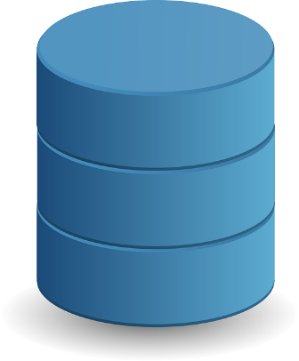

Majors between Traditional Data & Big Data
TRADITIONAL DATA | BIG DATA
Traditional Data
Big Data
Traditional data is generated in enterprise level. | Big data is generated in outside and enterprise level.
Its volume ranges from Gigabytes to Terabytes. | Its volume ranges from Petabytes to Zettabytes or Exabytes.
Traditional database system deals with structured data. | Big data system deals with structured, semi structured and unstructured data.
Traditional data is generated per hour or per day or more. | But big data is generated more frequently mainly per seconds.
Traditional data source is centralized and it is managed in centralized form. | Big data source is distributed and it is managed in distributed form.

Slide 44
Majors between Traditional Data & Big Data
TRADITIONAL DATA | BIG DATA
Traditional Data
Big Data
Data integration is very easy. | Data integration is very difficult.
Normal system configuration is capable to process traditional data. | High system configuration is required to process big data.
The size of the data is very small. | The size is more than the traditional data size.
Traditional data base tools are required to perform any data base operation. | Special kind of data base tools are required to perform any data base operation.
Normal functions can manipulate data. | Special kind of functions can manipulate data.

Slide 45
Majors between Traditional Data & Big Data
TRADITIONAL DATA | BIG DATA
Traditional Data
Big Data
Its data model is strict schema based and it is static. | Its data model is flat schema based and it is dynamic.
Traditional data is stable and inter relationship. | Big data is not stable and unknown relationship.
Traditional data is in manageable volume. | Big data is in huge volume which becomes unmanageable.
It is easy to manage and manipulate the data. | It is difficult to manage and manipulate the data.
Its data sources includes ERP transaction data, CRM transaction data, financial data, organizational data, web transaction data etc. | Its data sources includes social media, device data, sensor data, video, images, audio etc.

Slide 46
Confidentiality & Data Accuracy
Confidentiality involves setting up a set of rules and restrictions to limit access to confidential data.
It’s generally treated with access control and cryptographic mechanisms.
The areas of research to improve the confidentiality of data in Big Data are concerned with issues such as:
Merging and integrating of access control policies,
Automatic management of these policies,
Automatic administration of authorizations,
Application of access control on Big Data platforms, etc.

Slide 47
Flexibility
A traditional database is based on a fixed schema that is static in nature.
It could only work with structured data that fit effortlessly into relational databases or tables. In reality, most data is unstructured. The extensive variety of unstructured data requires new methods to store and process. Some examples include movies and sound files, images, documents, data, text, weblogs, strings, and web content.

Slide 48
Data Storage Size
The size of limit in data is huge.
In traditional data, its hard to store a large amount of data.
The primary certain entirely can be taken care of data

Slide 49
Different Types of Data

Slide 50
Case Study of Big Data Solutions

Slide 51
Case Study of Big Data Solution
Undoubtedly Big Data has become a major game change in most part of the cutting edge industries over the last few years.
As Big Data keeps on going day by day, the number of various organizations that are adopting Big Data keeps on expanding.
Let’s discuss example:
An e-commerce site XYZ (having 100 million users) wants to offer a gift voucher of 100$ to its top 10 customers who have spent the most in the previous year.
Moreover, they want to find the buying trend of these customers so that company can suggest more items related to them.
Issues: Huge amount of unstructured data which needs to be stored, processed and analyzed.
Solution:
Storage: This huge amount of data, Hadoop uses HDFS (Hadoop Distributed File System) which uses commodity hardware to form clusters and store data in a distributed fashion. It works on Write once, read many times principle.
Processing: Map Reduce paradigm is applied to data distributed over network to find the required output.
Analyze: Pig, Hive can be used to analyze the data.
Cost: Hadoop is open source so the cost is no more an issue.

Slide 52
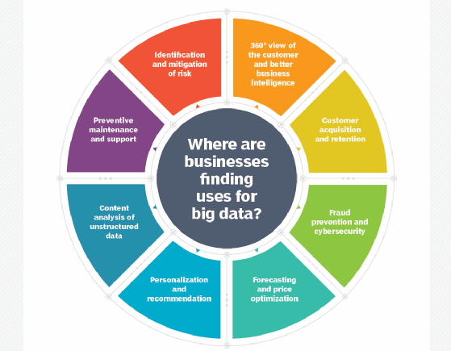
Where are businesses finding uses for Big Data ?

Slide 53
Walmart
Biggest retiler in the world and world’s biggest organization by revenue.
Approx. 2 million workers and 20000 stores in 28+ nations.
It started to use Big Data concept in earlier stage.
It used data mining to find designs pattern that can be used to give product suggestions to client, depending on which products were brought together.
Based on data mining result, it has expanding its conversion rate of customers.
Main taget of walmart is to holding customers and enhance their experience.
Hadoop and NoSQL technologies are used to furnished these customers real time data to gathered from various sources and their effective valuable use.

Slide 54
Uber
It is the best option for individuals around the globe when moving people and making conveyances.
It utilizes individuals information of the user to intently monitor which features of services are used.
To analyze usage pattern and to figure out where the services should be more engaged.
It focuses around the oraganic market of the services because of which the costs of services gave changes.
The use of data is surge pricing and its influences the rate of demand.

Slide 55
Netflix
It is very popular entertainment company work in online on-request web based video streaming for its customers.
It has been determined to be able to predict what precisely its customers will appreciate viewing with Big Data.
Recently, Netflix begun positioning itself as a content creator, not simply a distribution medium which is solidly said based on data analytics.
Data likes are recommandation engines take care of customers watch, regularly playback halted, ratings and so on.
It has incorporates with Hadoop, Hive and Pig and other traditional business intelligence.

Slide 56
More Case Studies of Big Data
https://www.scnsoft.com/blog/big-data-use-cases-stats-and-examples
https://www.tableau.com/learn/articles/big-data-examples-use-cases

Slide 57
Big Data Analytics(BDA)
GTU #3170722
Prof. Maulik D Trivedi
Computer Engineering Department
maulik.trivedi@darshan.ac.in
9998 265 805

